Slide 1



AGE 214: Lecture 14
Basic Op-Amp Circuits & Applications
Sokoine University of Agriculture
AGE 214 - Lecture 14

Slide 2


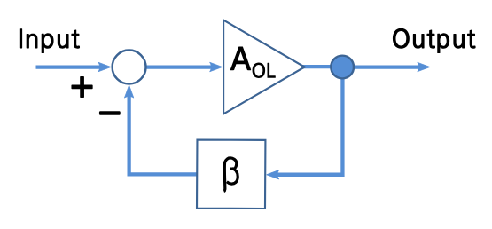
The Concept of Negative Feedback
Why Feedback?
Open loop gain is too high ($\infty$) and unstable. Negative feedback feeds a portion of the output back to the inverting input.
•
Trade-off: We sacrifice Gain for Stability.
•
Benefits: Linear operation, controlled gain, wider bandwidth.
Sokoine University of Agriculture
AGE 214 - Lecture 14

Slide 3

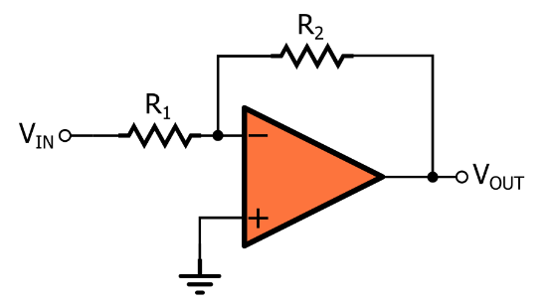
1. Inverting Amplifier
Construction
•
Input signal ($V_{in}$) connected to Inverting (-) terminal via $R_{in}$.
•
Non-Inverting (+) terminal is Grounded.
•
Feedback Resistor ($R_f$) connects Output to Input (-).
Sokoine University of Agriculture
AGE 214 - Lecture 14

Slide 4

Inverting Gain Formula
Applying Virtual Ground
Since (+) is at 0V, (-) is also at 0V (Virtual Ground).
Current through $R_{in}$ equals current through $R_f$ (No current into Op-Amp).
The negative sign indicates a 180° phase shift.
Sokoine University of Agriculture
AGE 214 - Lecture 14

Slide 5
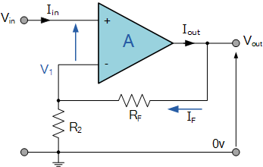
2. Non-Inverting Amplifier
Construction
•
Input signal ($V_{in}$) connected directly to Non-Inverting (+) terminal.
•
Feedback is applied to the (-) terminal.
•
Output and Input are in phase.
Sokoine University of Agriculture
AGE 214 - Lecture 14

Slide 6

Non-Inverting Gain Formula
Derivation
Voltage at (-) terminal is equal to $V_{in}$ (Golden Rule).
The resistors form a voltage divider.
Notice: The gain is always greater than or equal to 1.
Sokoine University of Agriculture
AGE 214 - Lecture 14

Slide 7
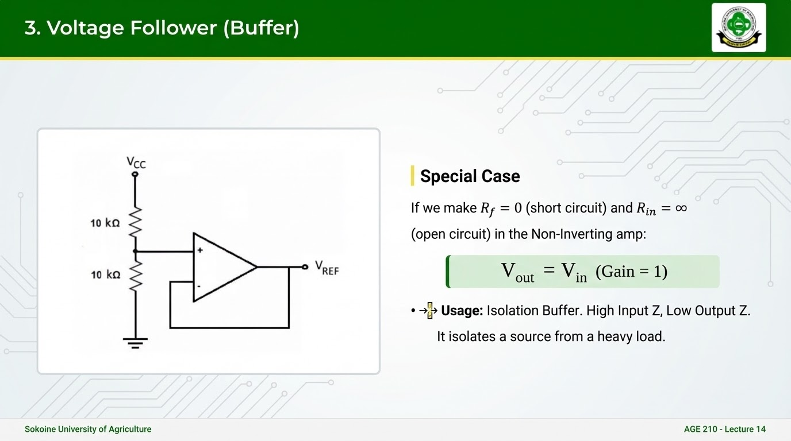

Slide 8
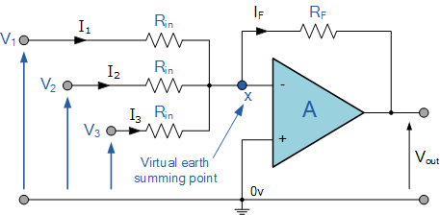


4. Summing Amplifier (Adder)
Mathematical Addition
Multiple inputs connect to the Inverting terminal via resistors.
The currents sum up at the Virtual Ground node.
Sokoine University of Agriculture
AGE 214 - Lecture 14

Slide 9
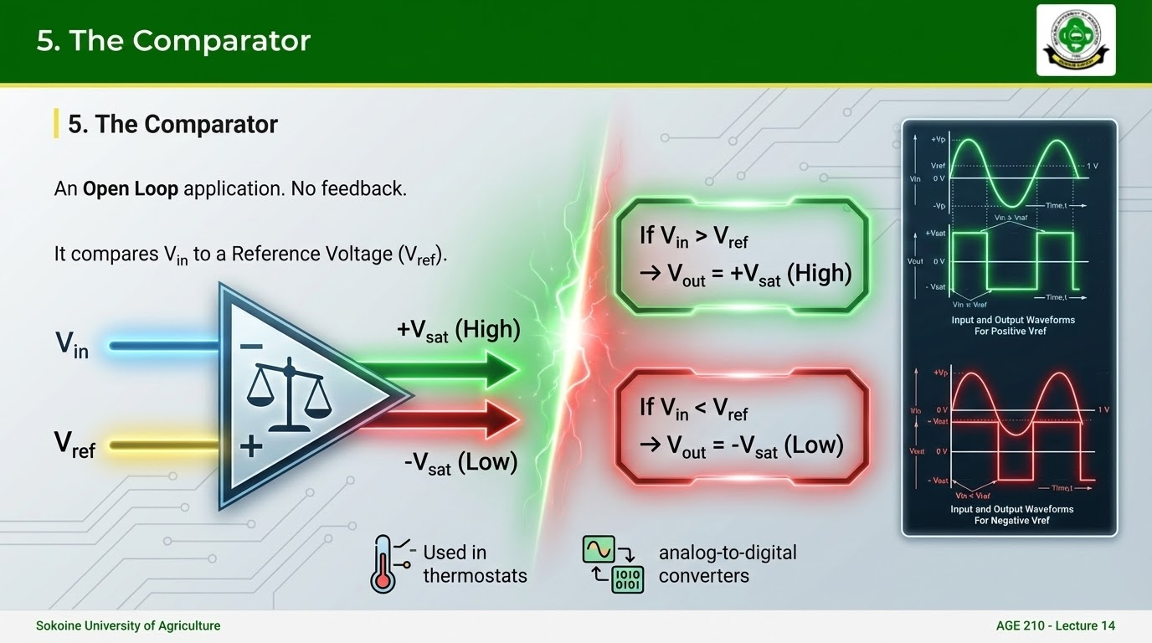

Slide 10
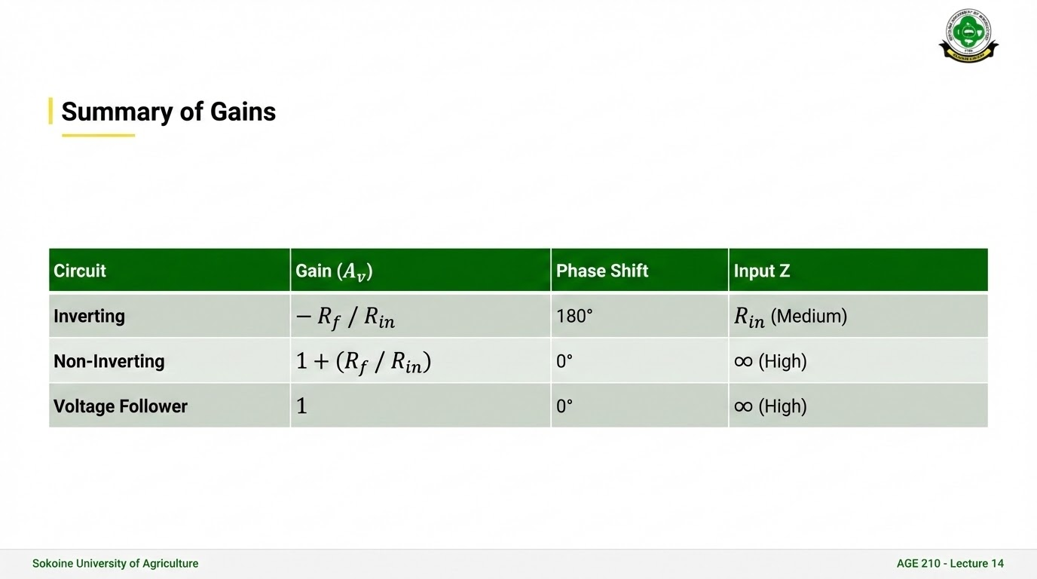

Slide 11
Questions?
Next Lecture: Power Electronics & Transducers
Dr. Kadeghe Fue
Sokoine University of Agriculture
AGE 214 - Lecture 14

Slide 12






Image Sources
https://www.sua.ac.tz/themes/custom/suaweb/logo.svg
Source: www.sua.ac.tz
https://upload.wikimedia.org/wikipedia/commons/6/6e/Block_Diagram_for_Feedback.svg
Source: en.wikipedia.org
https://www.allaboutcircuits.com/uploads/thumbnails/Signal_Inversion.png
Source: allaboutcircuits.com
https://www.electronics-tutorials.ws/wp-content/uploads/2018/05/opamp-opamp15.gif?resize=346%2C219
Source: electronics-tutorials.ws
https://www.allaboutcircuits.com/uploads/articles/Voltage-follower_application_example.jpg
Source: www.allaboutcircuits.com
https://www.electronics-tutorials.ws/wp-content/uploads/2013/08/opamp11.gif
Source: www.electronics-tutorials.ws

Slide 13

Image Sources
https://circuitstoday.com/wp-content/uploads/2009/09/741-IC-Op-Amp-Non-Inverting-Comparator-Waveform.jpg
Source: circuitstoday.com

